Slide 1

Dec.12
Pecha Kucha
Sophie Wang
Chelsea Fine Art

Slide 2
Dec.12
Why DPS?
ESACPE！
-Not ready to graduate
confused

Slide 3
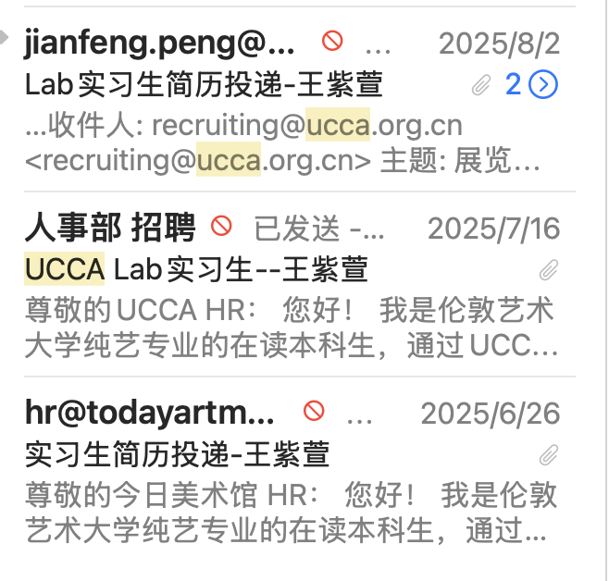
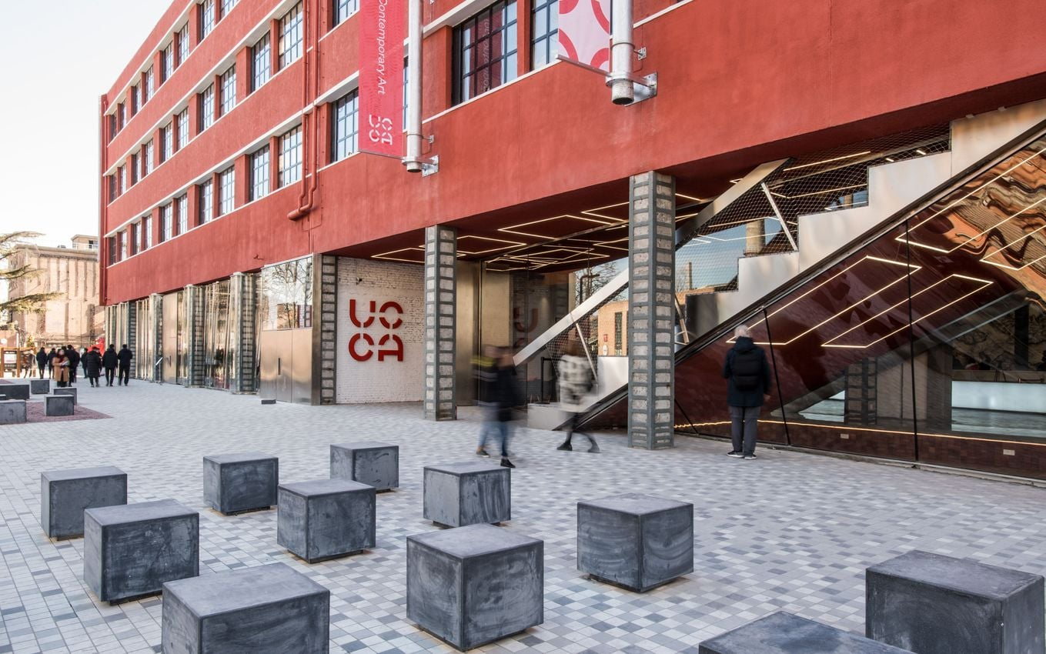
Dec.12
Placement
UCCA Center for Contemporary Art
798 Art District, Beijing, China
persistence
Success！

Slide 4
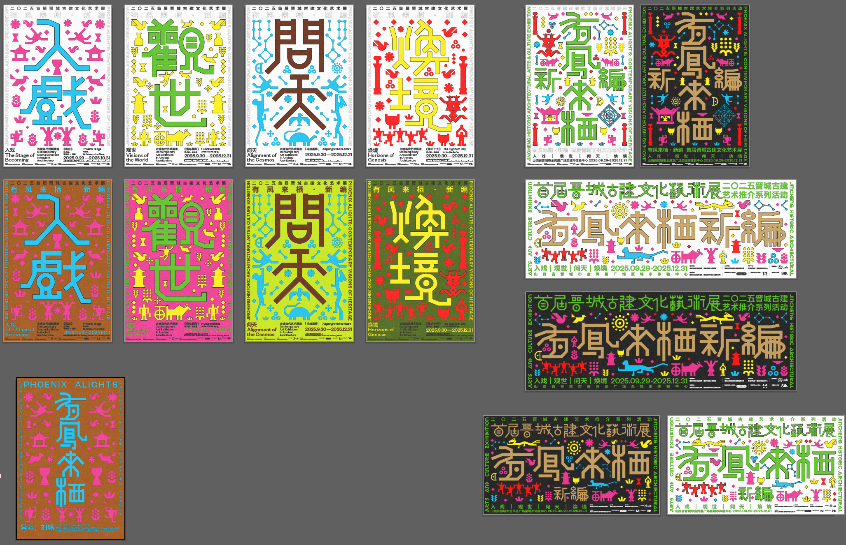
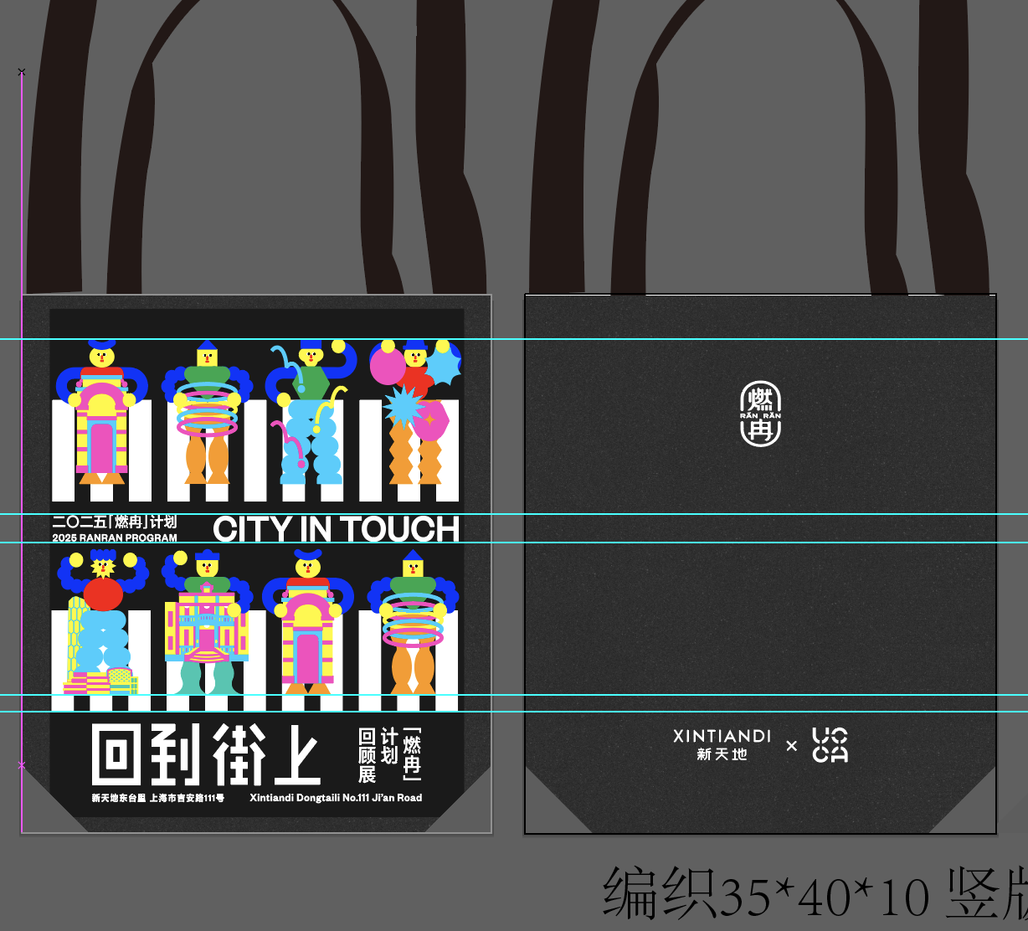
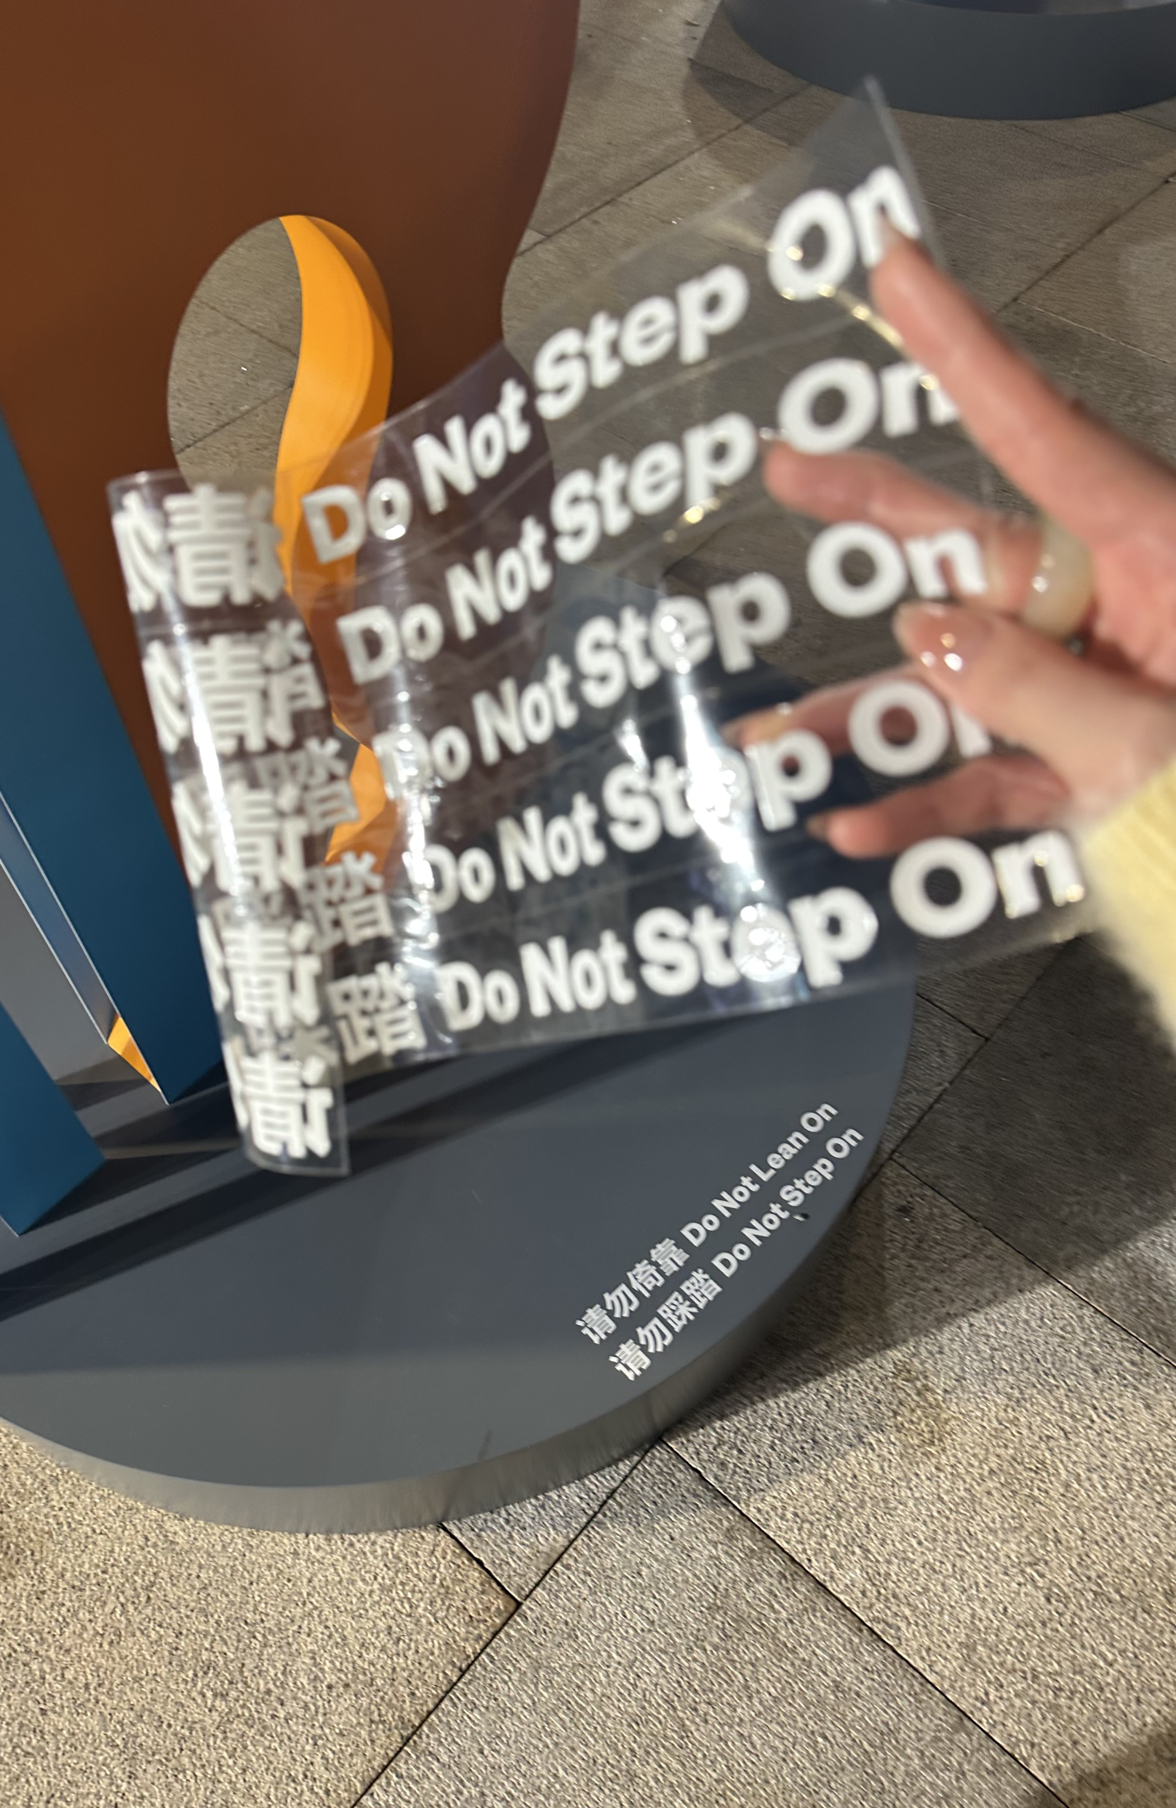

Dec.12
UCCA Lab
Curating collaborative art program with brands, enterprises and government
Graphic design
researching
Curatorial execution
Contacting

Slide 5
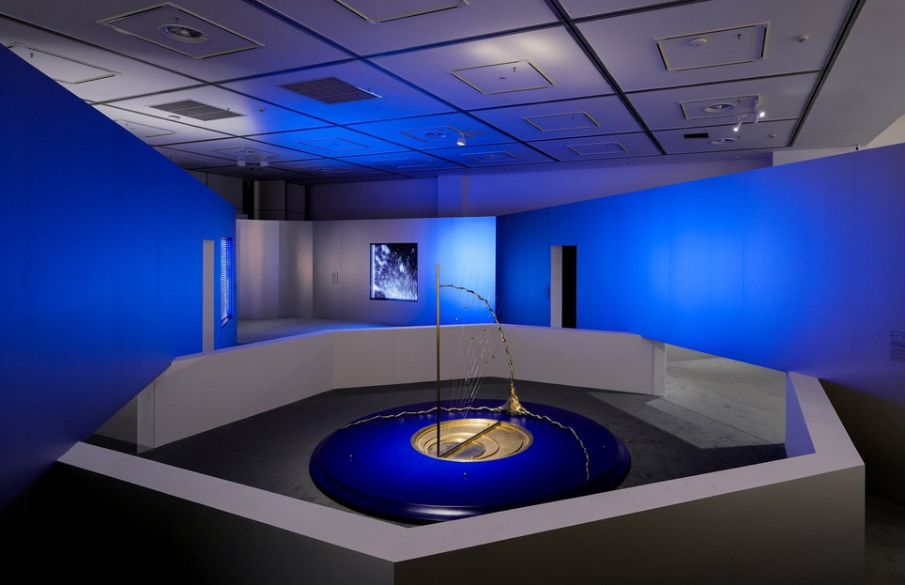
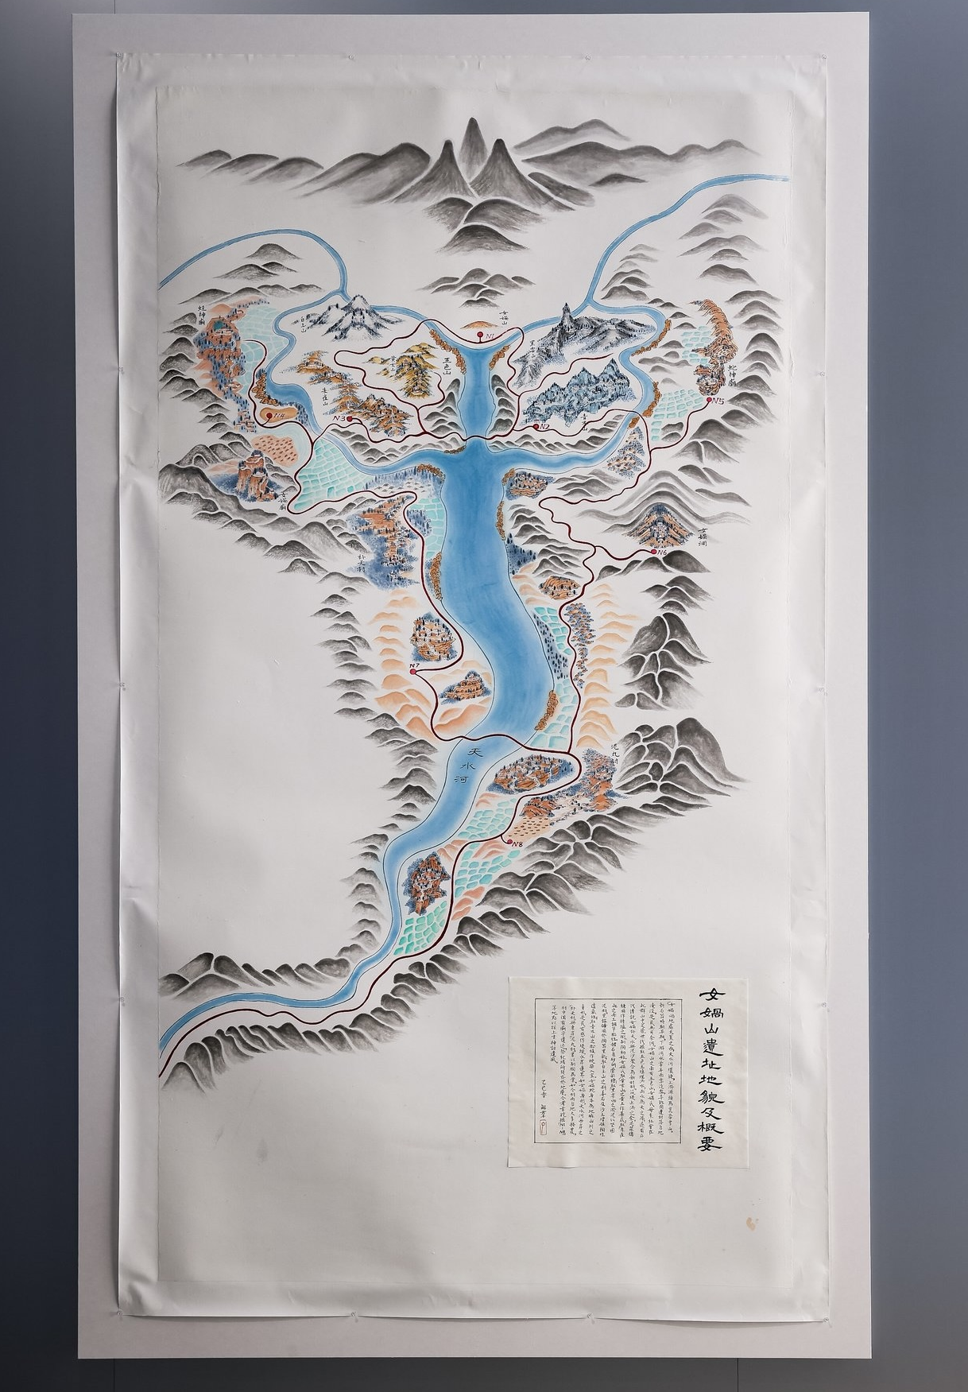
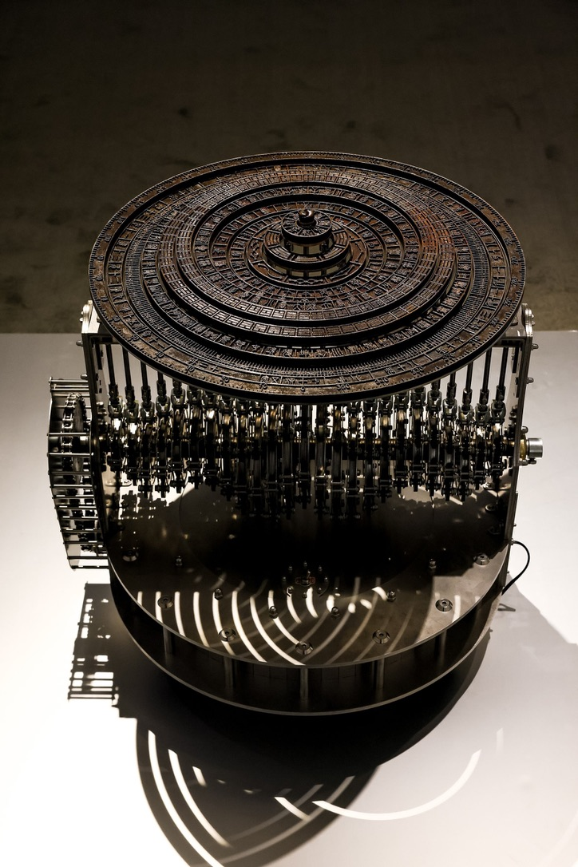
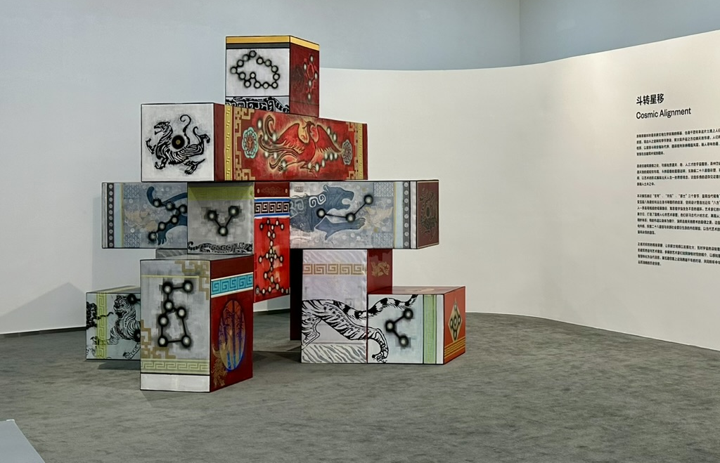
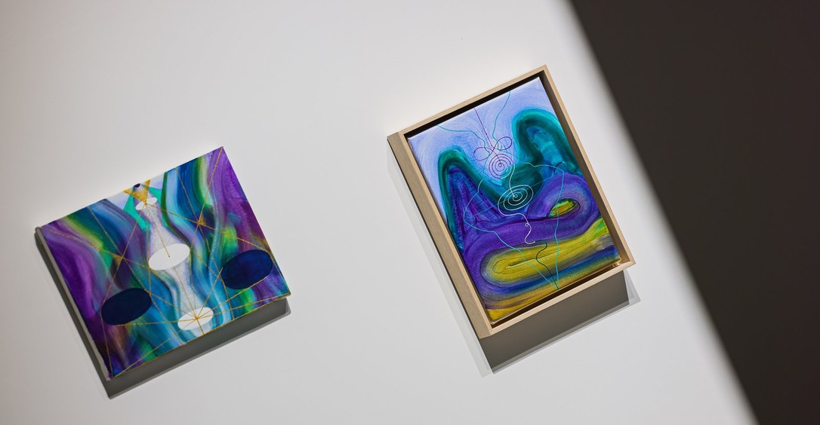
Dec.12
“Cosmic Alignment” October,2025
inspiration--
universe, culture, Existentialism …

Slide 6
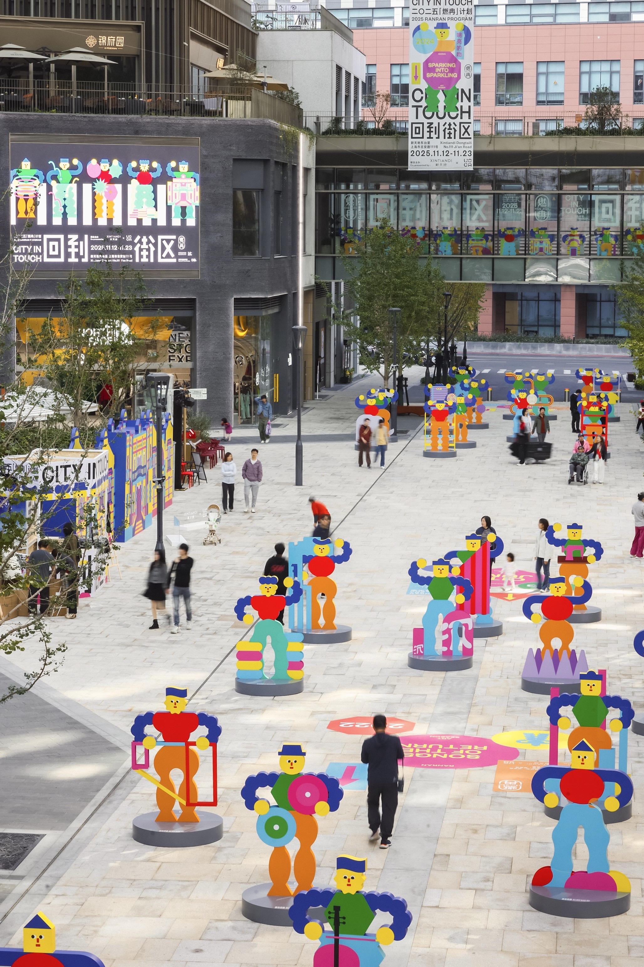

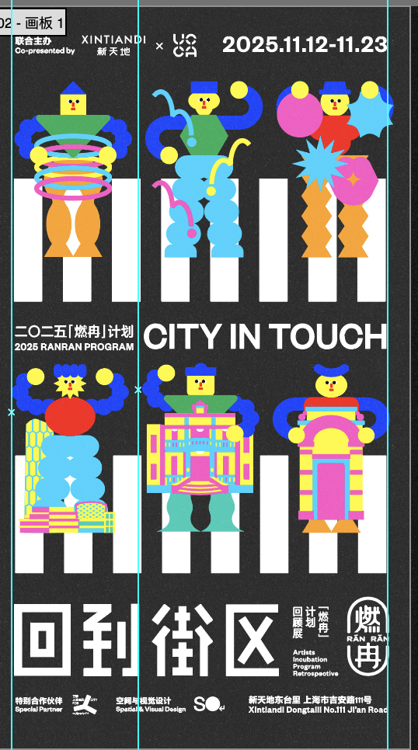
Dec.12
“City in touch！” November, 2025
Positionality & interpretation

Slide 7
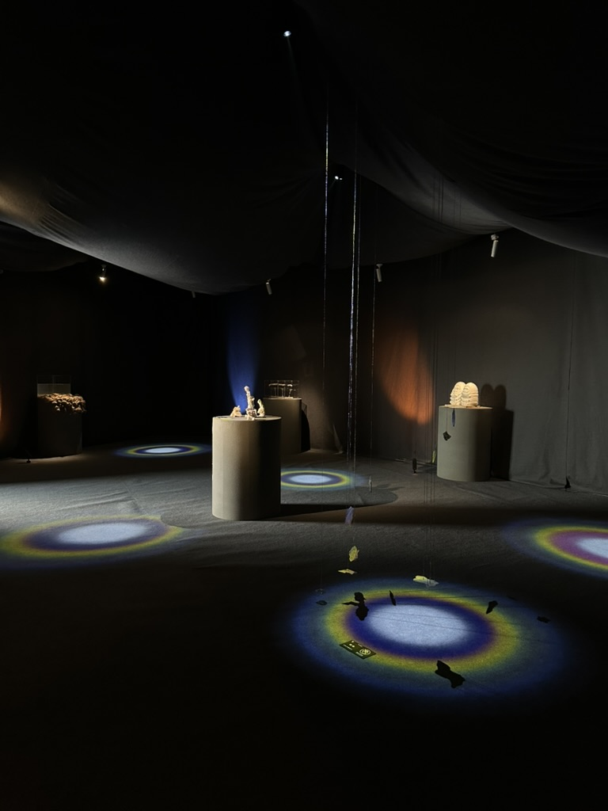
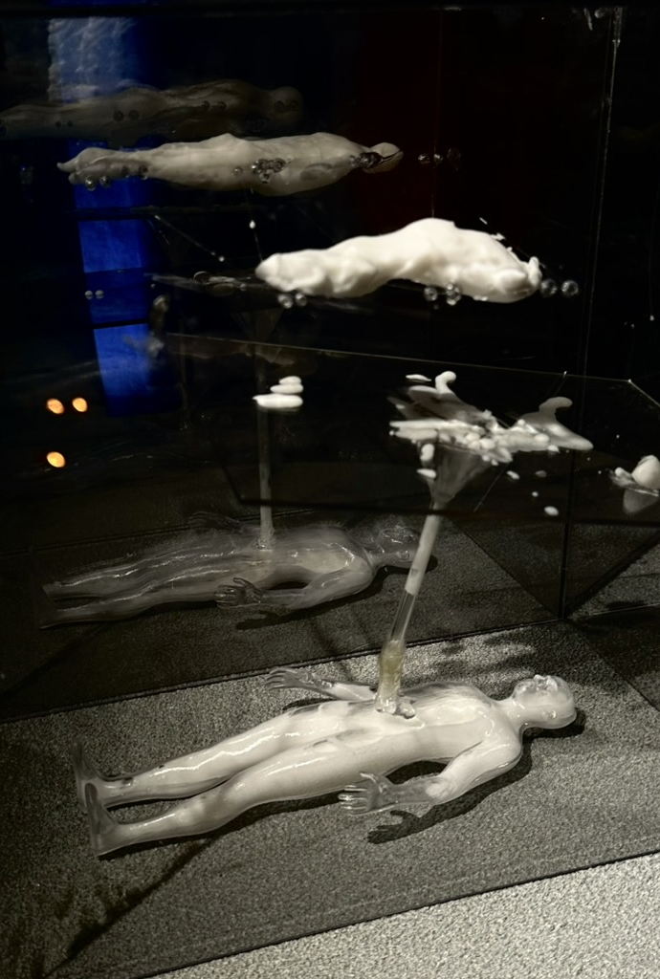
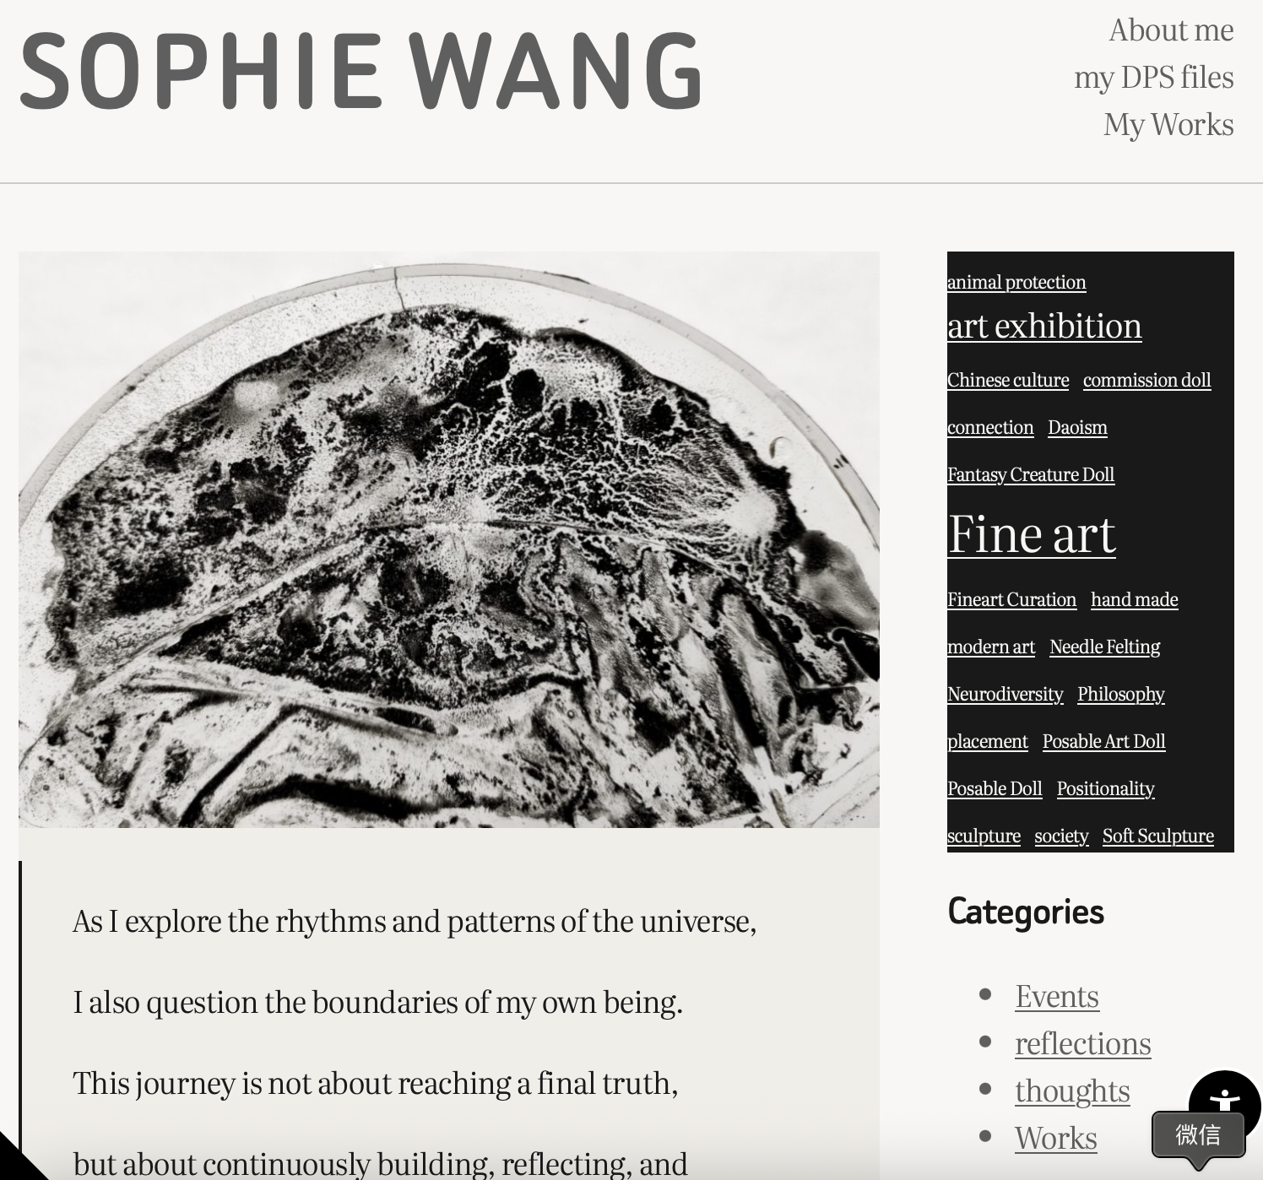
Dec.12
What else…
Exhibited -Community connection
Blog - documentation

Slide 8
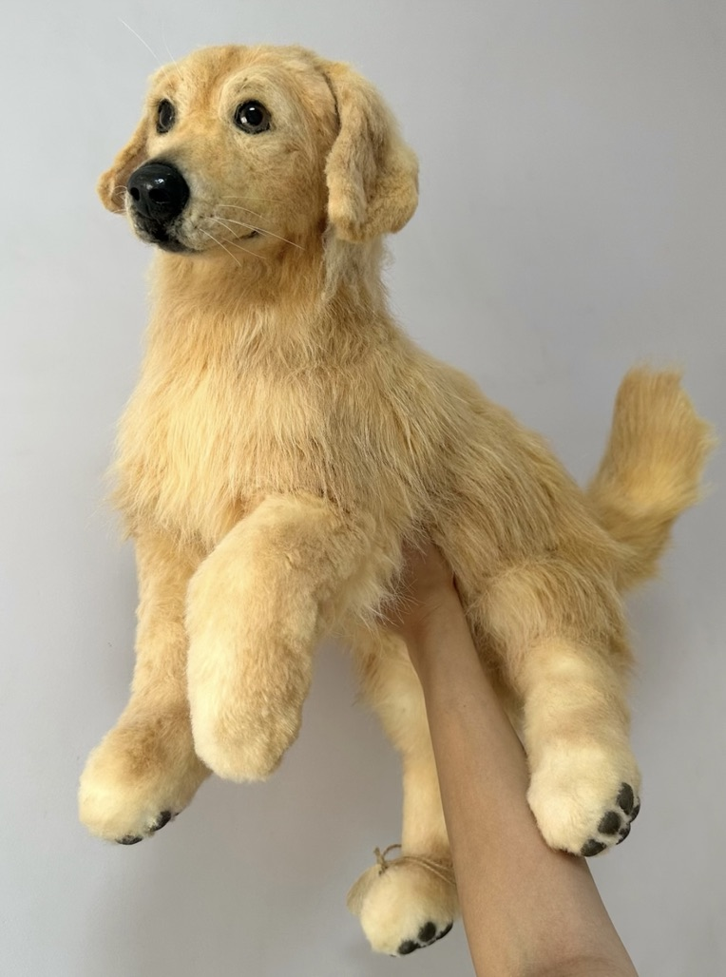
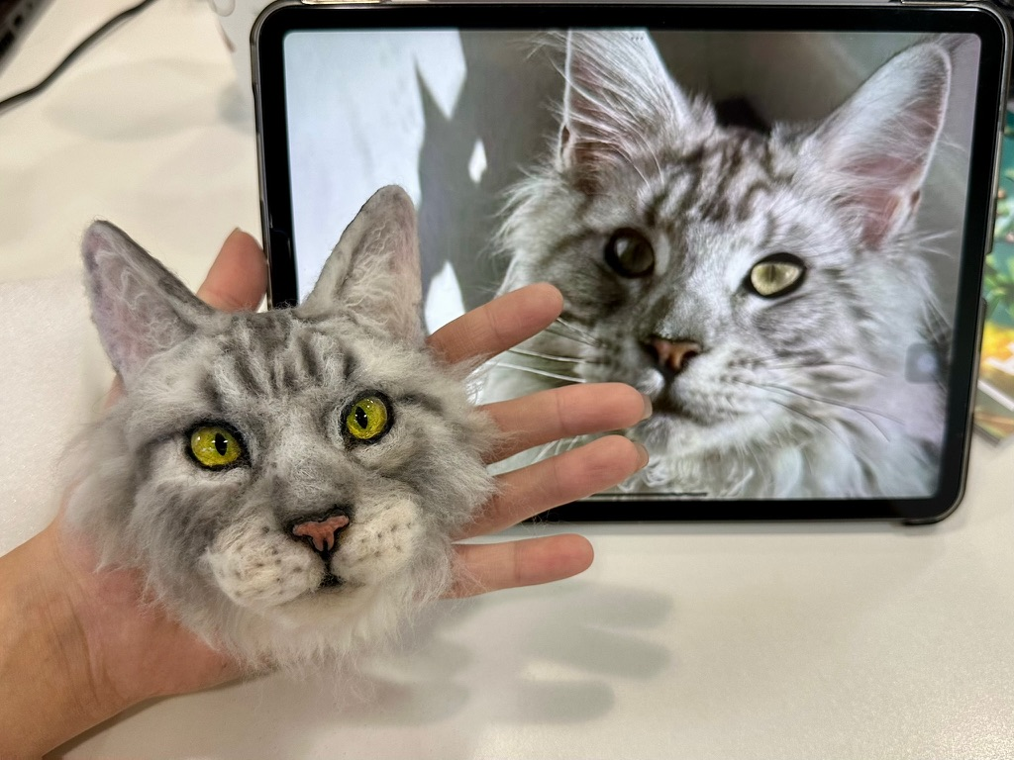
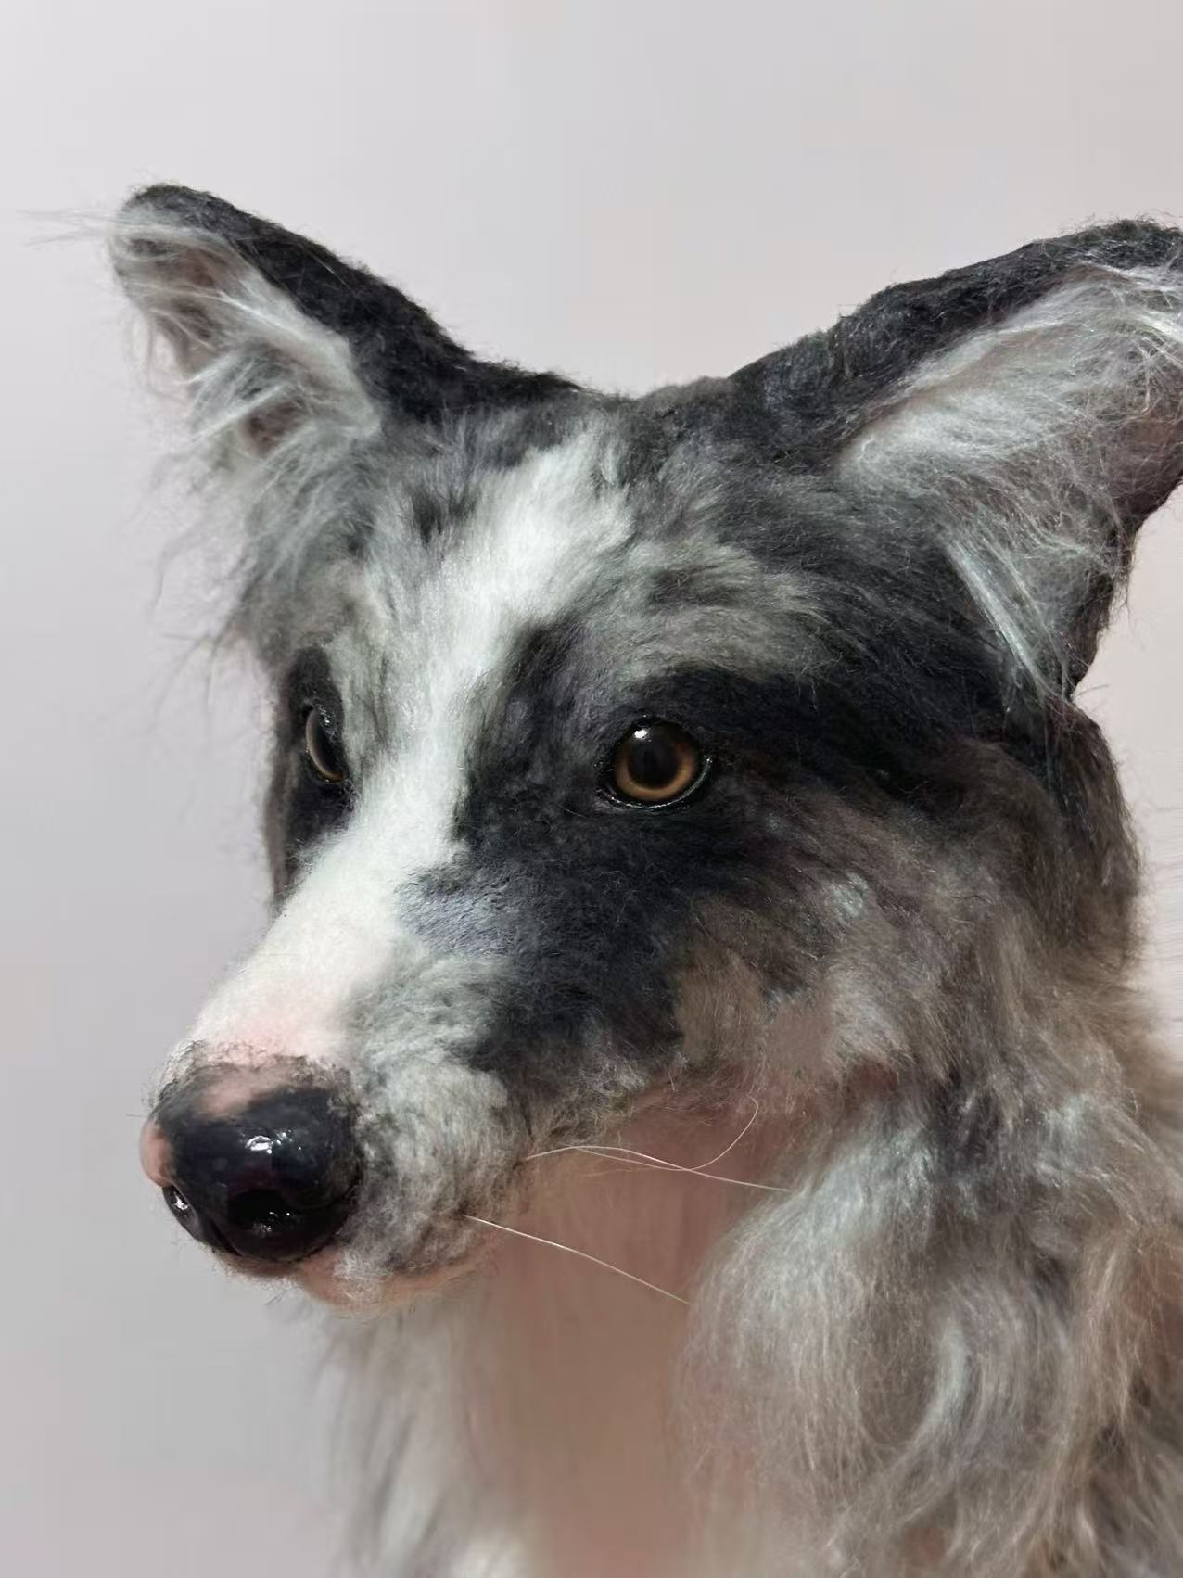
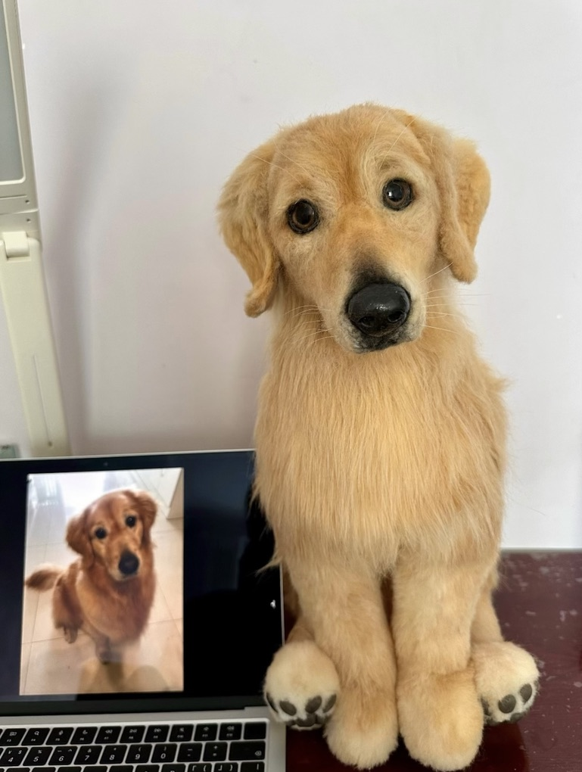
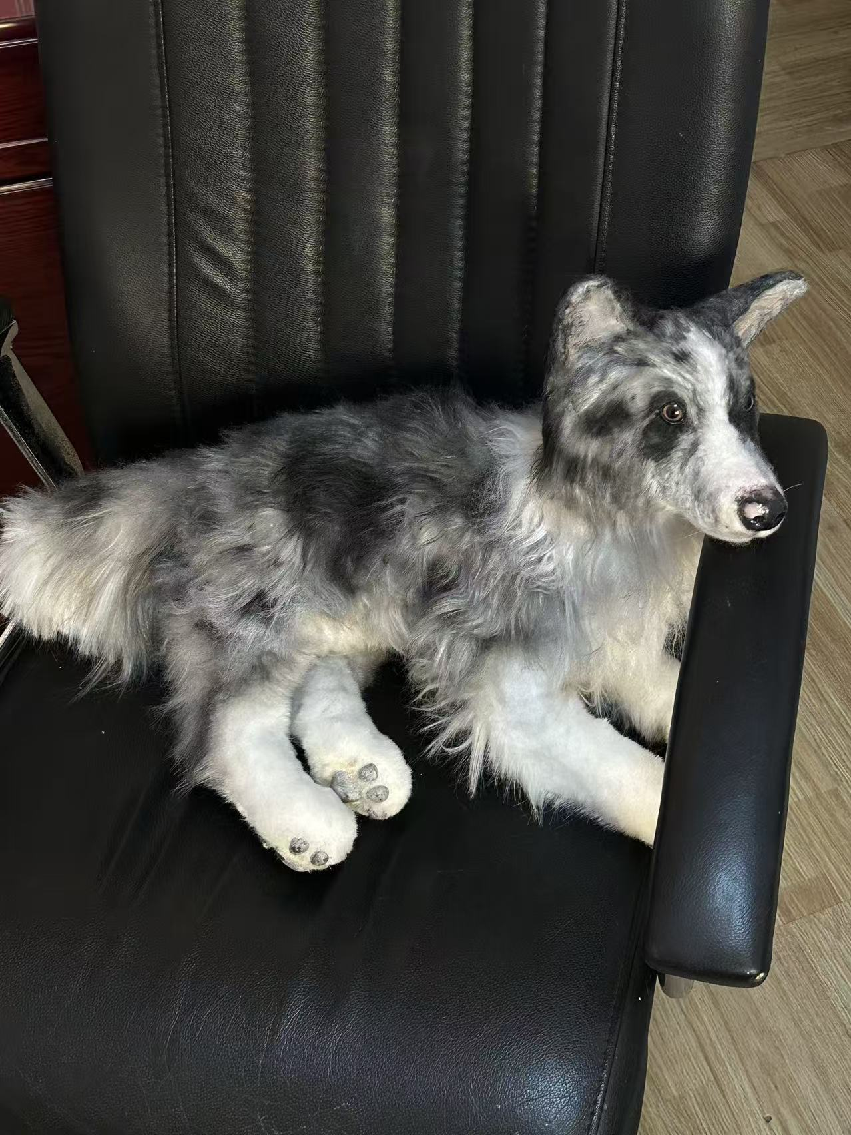
Dec.12
entrepreneurship
Posable Art Doll Commission
– memorial pets
Challenge-
Balance

Slide 9
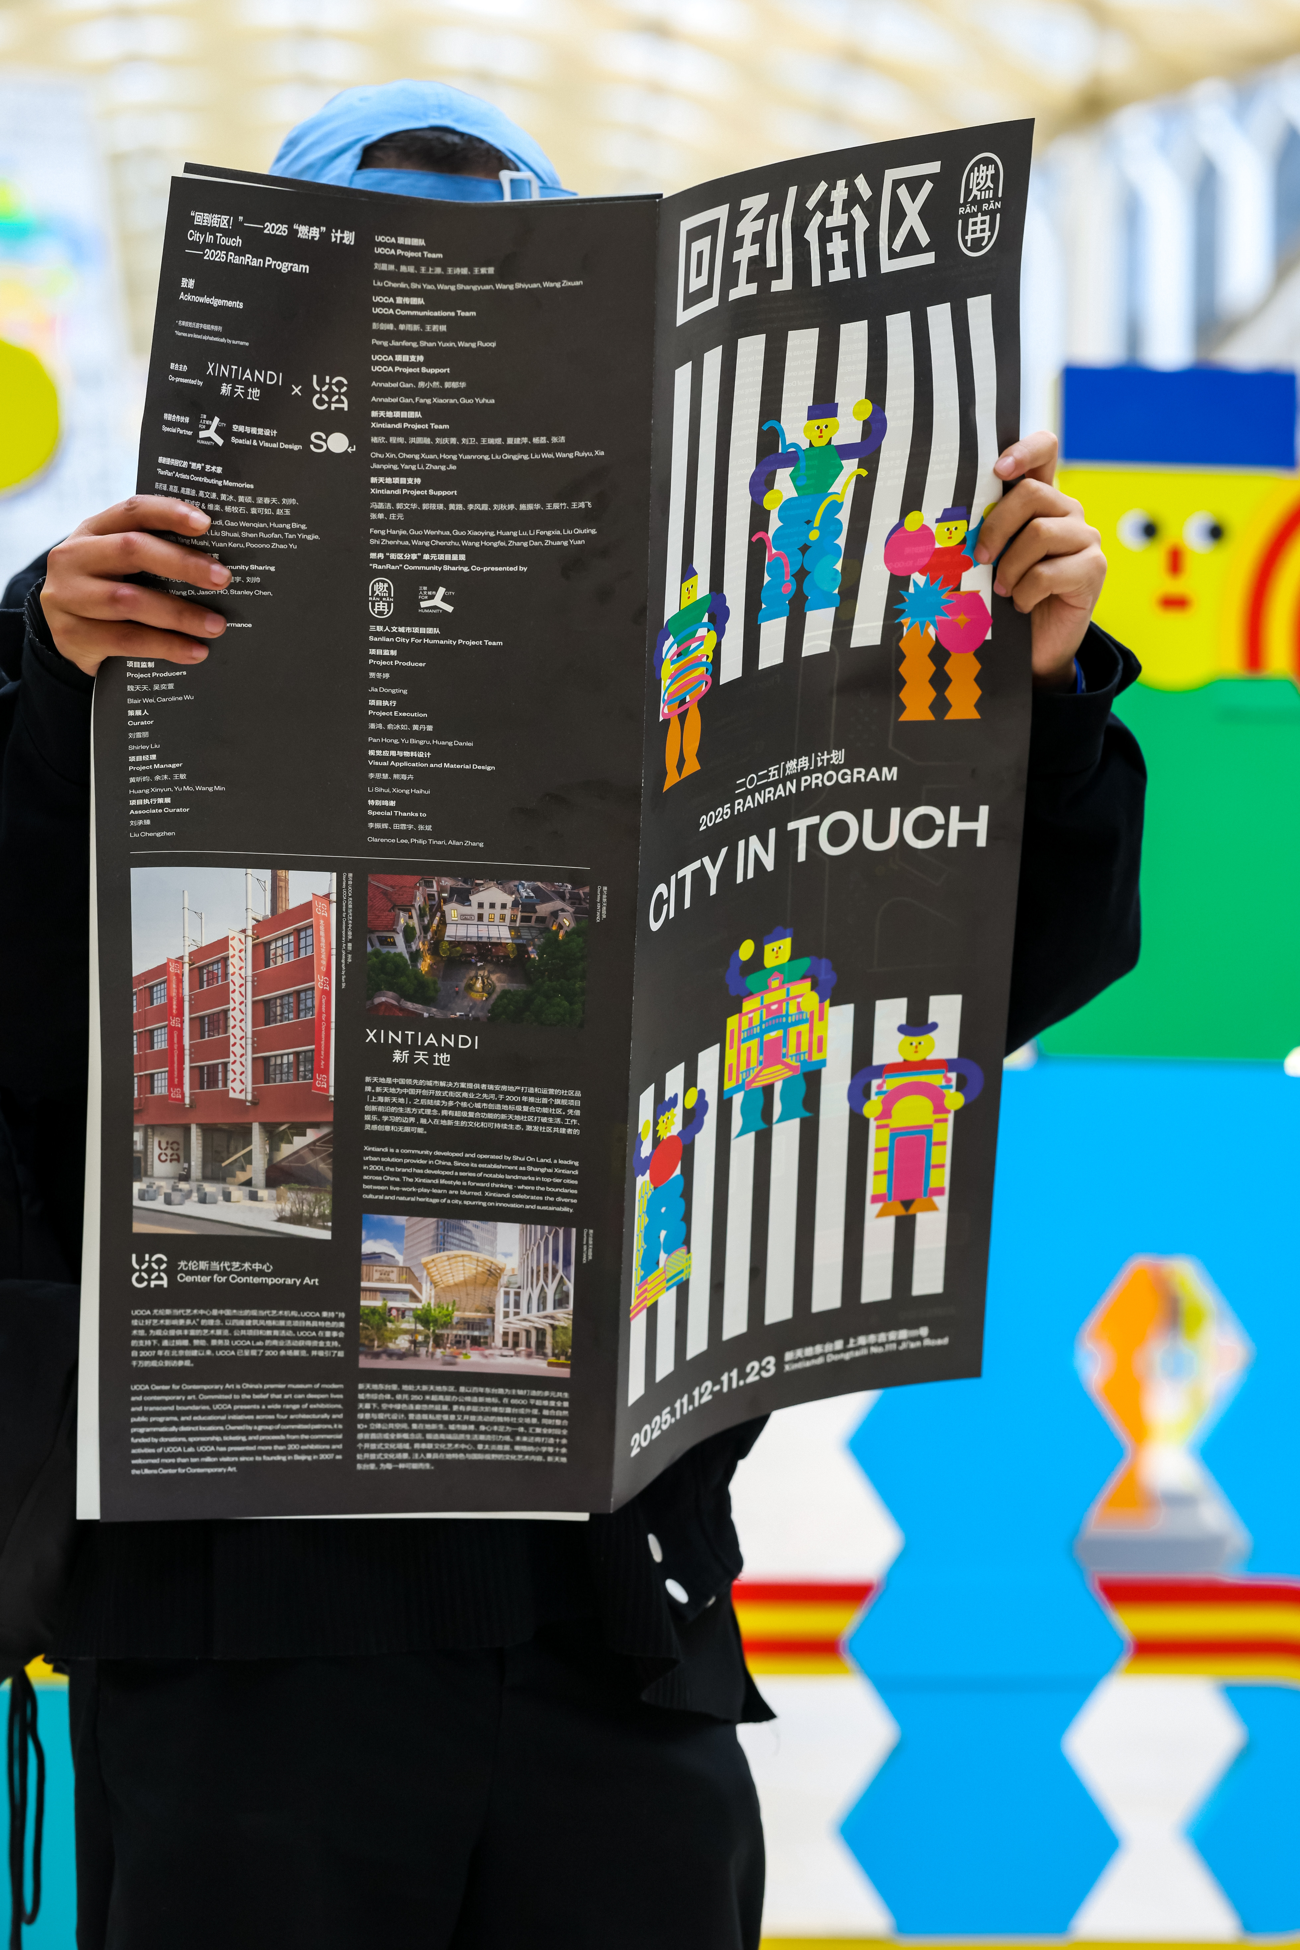
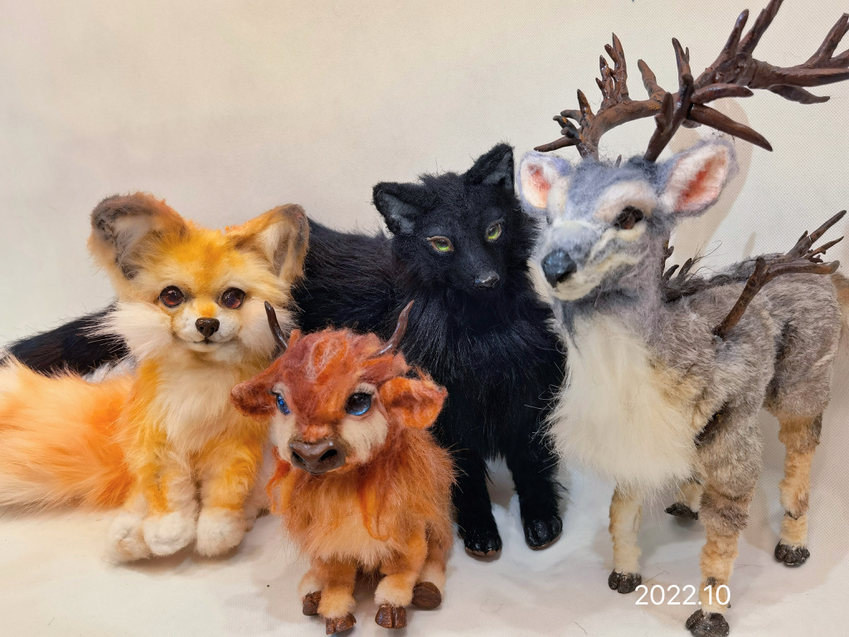
Dec.12
SIP Ideas
publication
(Philosophy, universe, Proto-civilizations…)
“the structure of the world”
charity/entrepreneurship
Animal Care & pet Memory

Slide 10
Dec.12
Thank you
Sophie Wang

